Slide 1
WIND EROSION & DEPOSITION

Slide 2
Have you ever seen a desert? In movies or in real life?
What was it like?
Are there any natural landforms that are common in a sandy desert?
Are there any other places you might expect to see these?
Why? What do these places have in common?

Slide 3
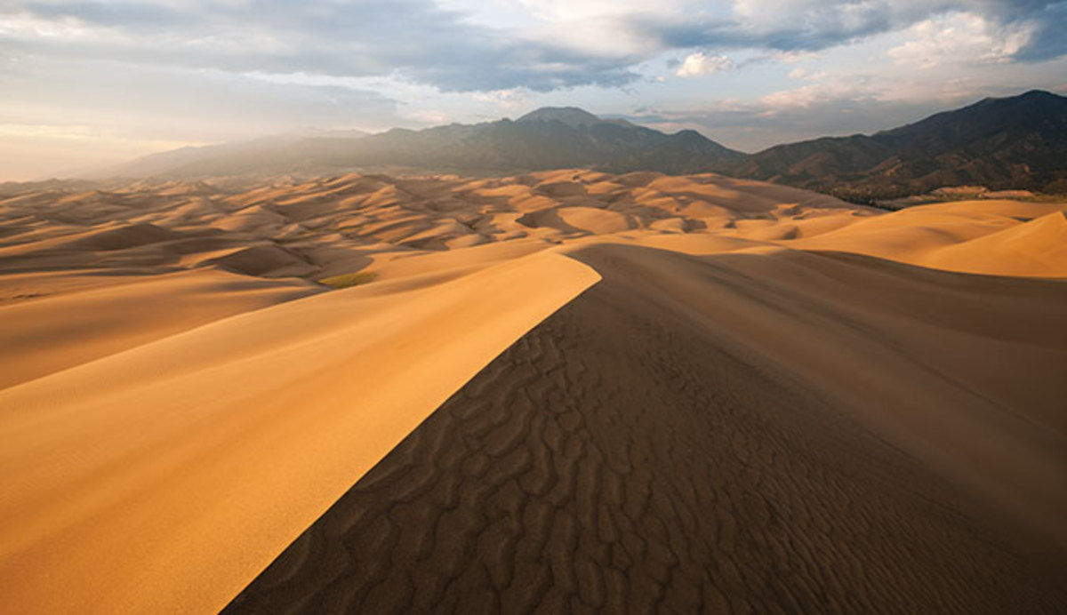
What Forms Sand Dunes?

Slide 4
Where does wind erosion have the most effect?
Wind is the least powerful form of erosion by itself
(What are the others that have a stronger effect?)
water, waves, ice
Why does it have such effect in desert areas?
few plants to hold the soil in place
sand is dry and light

Slide 5
How does wind cause erosion?
Wind causes erosion by deflation and abrasion
Deflation: removal of surface materials.
wind picks up smallest particles of sediment
stronger the wind, larger the sediment it can pick up
Which particles can move the fastest and farthest?
Which particles take the highest wind speeds to move?

Slide 6
Desert Pavement
No sand (it’s all been blown away)
Only heavier rocks

Slide 7
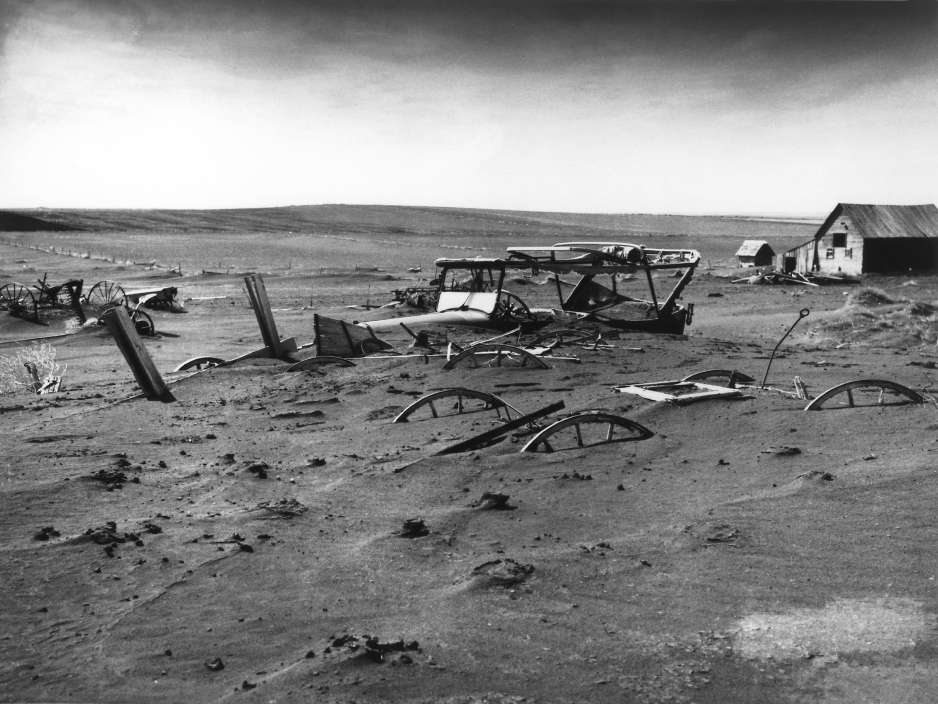
Dustbowl 1936 – wind deflation removing huge amounts of fertile topsoil caused mass exodus from great plains

Slide 8
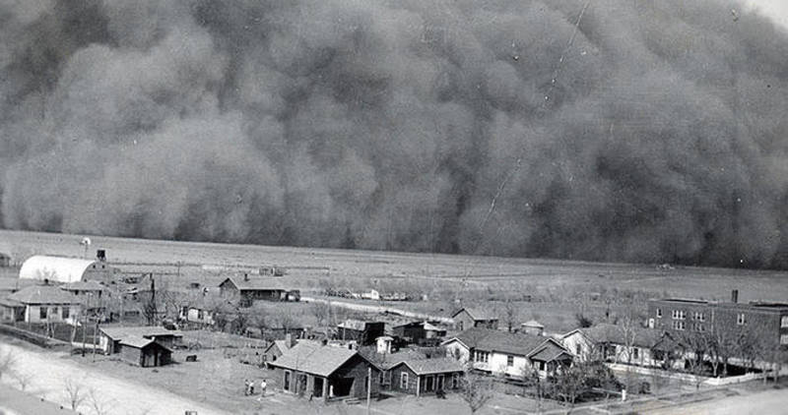

Slide 9
How does wind cause erosion?
Wind causes erosion by deflation and abrasion
Abrasion: wind-carried sand polishes rock
This causes little erosion, but still cause some.

Slide 10
Wind Deposition
Sand Dunes:
when wind strikes an obstacle
many different shapes (e.g. crescent or star shaped)
many sizes (up to 500 meters tall in China!)
move and shift over time as the wind changes
Loess (LES) Deposits:
sediment finer than sand that wind-deposited
can be very far from it’s source (why?)
helps to form fertile soil

Slide 11
Exit Ticket
At the bottom of your slides handout, 1) copy down these questions and 2) write the answers 3) yes you have to copy down the questions, don’t ask me if you have to.
What are two land formations that are created by wind deposits?
What are two reasons that wind erosion happens in the desert?
What is the difference between deflation and abrasion?
What is one land formation created by wind deflation?

