Slide 1
Part 1: Water, Glaciers, Wind, & Waves
Forces of Erosion

Slide 2
How Water Erodes
Water picks up and moves sediment
How does the sediment get there?
Most sediment washing or falls into a river as a result of mass movement and runoff.
Other sediment erodes from the bottom or sides of the river.
Abrasion: wearing away of rock by a grinding action
The amount of sediment a river carries is its load.

Slide 3
Load of a Stream
Largest sediment is at the bottom where it is rolled or bounced along
Fast-moving water lifts sand and other small sediment to carry it downstream (it is “suspended”)
Smallest sediment is entirely dissolved
The faster the water, the more load it can carry
DRAW A PICTURE:

Slide 4
Factors of River Erosion Power
A river’s slope, volume of flow, and the shape of its streambed all affect how fast the river flows and how much sediment it can erode
Slope: an increased slope generally means an increased speed
Faster water increases the river’s sediment load and power to erode.
Volume of Flow: the volume of water that moves past a point on a river in a given time. Increased volume (like during a flood), increases power to erode (sometimes x100!) sometimes moving huge amounts of sediment and even giant boulders
Streambed Shape: a Deep riverbed means there is less friction (less water comes in contact with the streambed, allowing the river to flow faster. A shallow river or one that has many obstacles (such as boulders) has increased friction, which slows down the river.
Obstacles can cause Turbulence (water moves every which way), and can increase power to erode.

Slide 5
Glaciers
Definition: a large mass of ice that moves slowly over land.
Types: continental glaciers and valley glaciers
Continental: spreads out over huge amounts of land (today only 10 percent of earth’s land– Antarctica and Greenland). Most of Ohio was once covered by a glacier that entirely covered Canada
Valley Glacier: long, narrow glacier that forms when snow an ice build up high in a mountain valley.
Glaciers can form only in an area where more snow falls than melts. Once it reaches a depth of more than 30-40 meters, gravity begins to pull the glacier downhill.

Slide 6
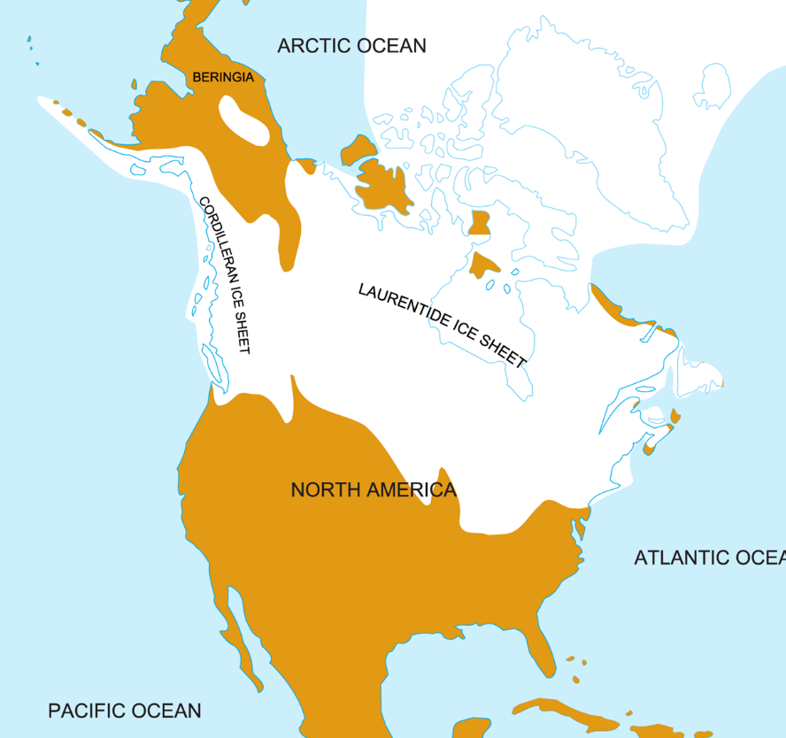
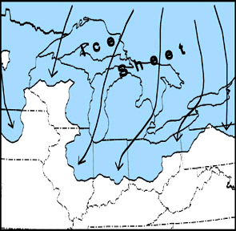
Continental Glacier during the Ice Age

Slide 7
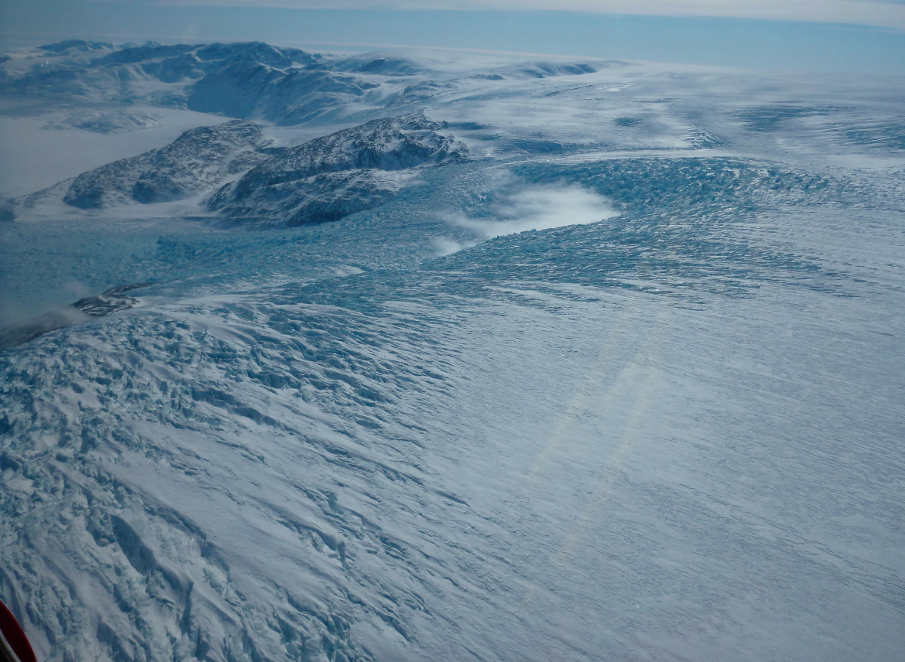
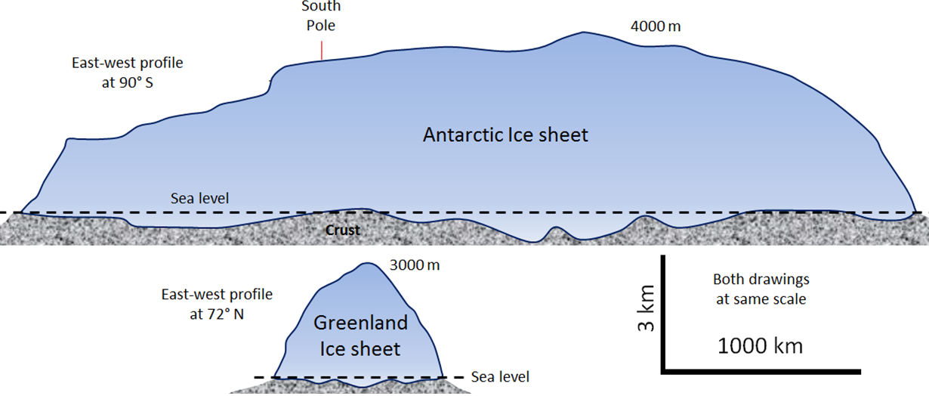
Antarctic Continental Glacier

Slide 8
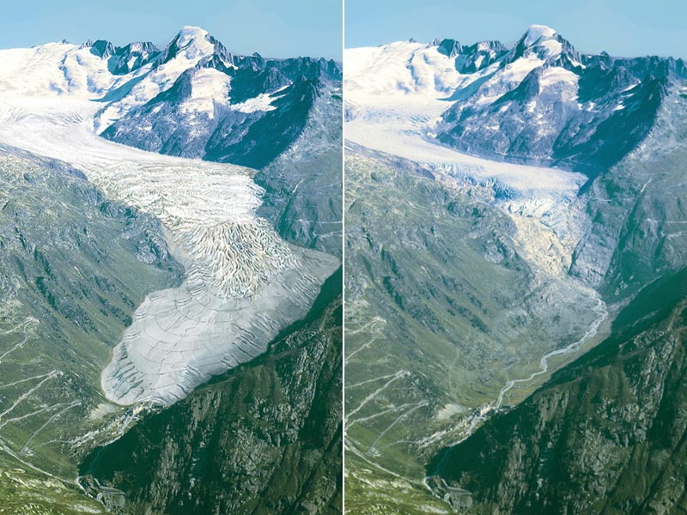
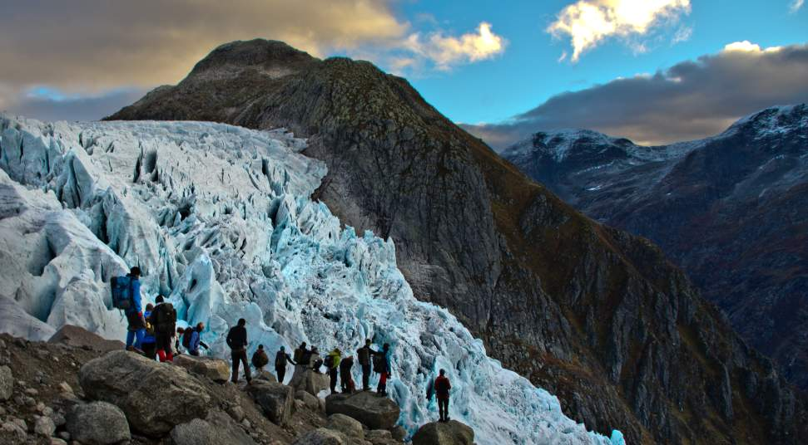
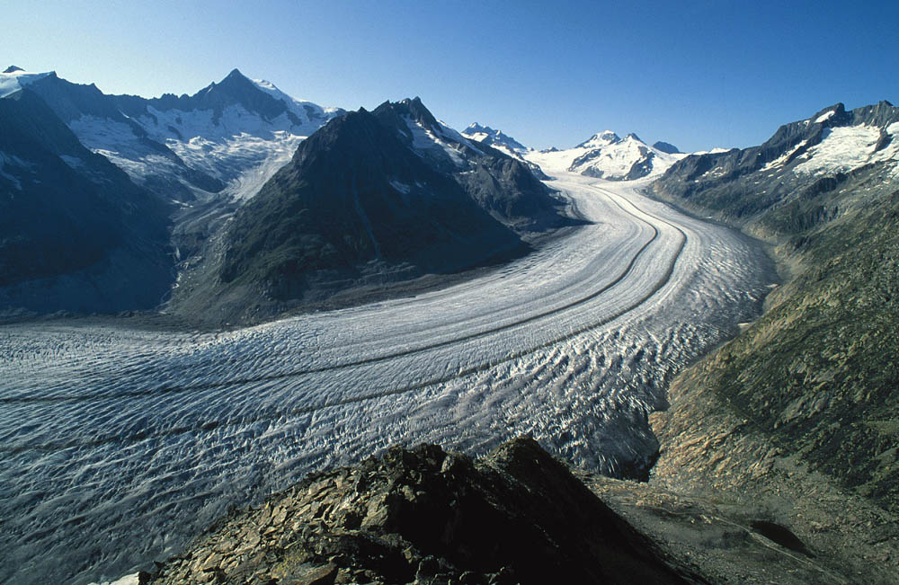
Valley Glaciers
Rhone Glacier– Swiss Alps

Slide 9
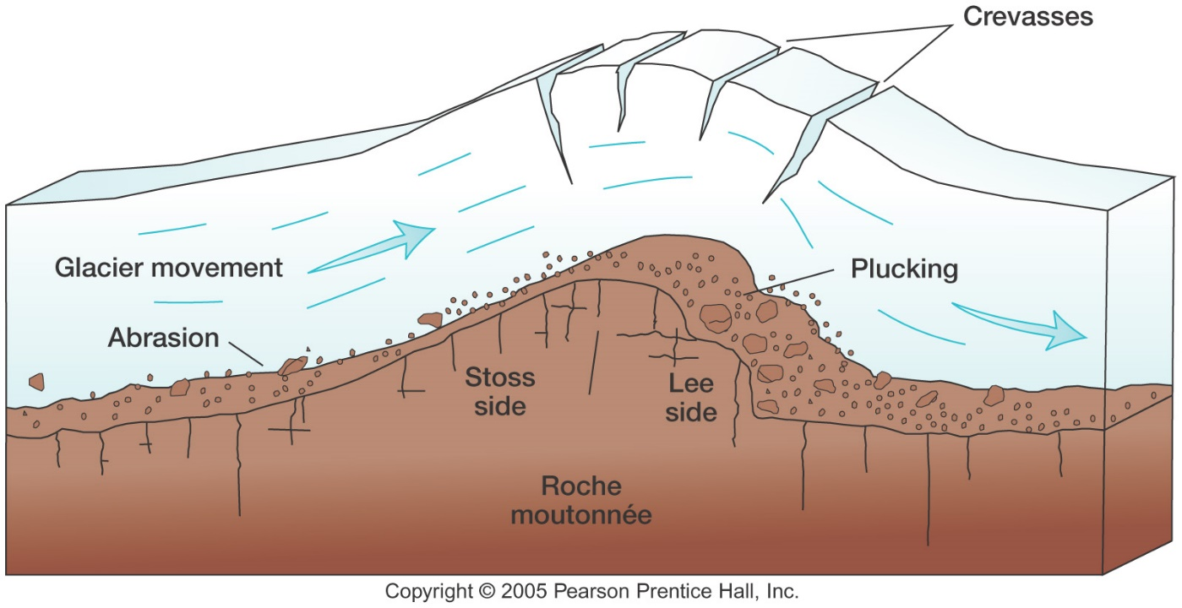
Glacier Erosion
Glaciers erode the land by plucking and abrasion.
Plucking: the weight of ice moving across the surface breaks off pieces of rocks and carries it along
Abrasion: many of the rocks that have been “plucked” are dragged along the bottom of the glacier forming gouges and scratches.

Slide 11
Glacial Striations

Slide 12
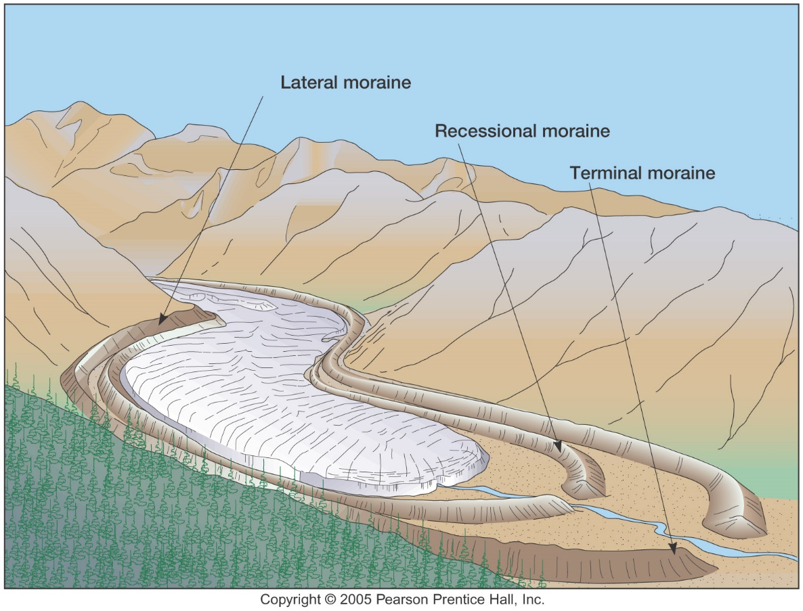
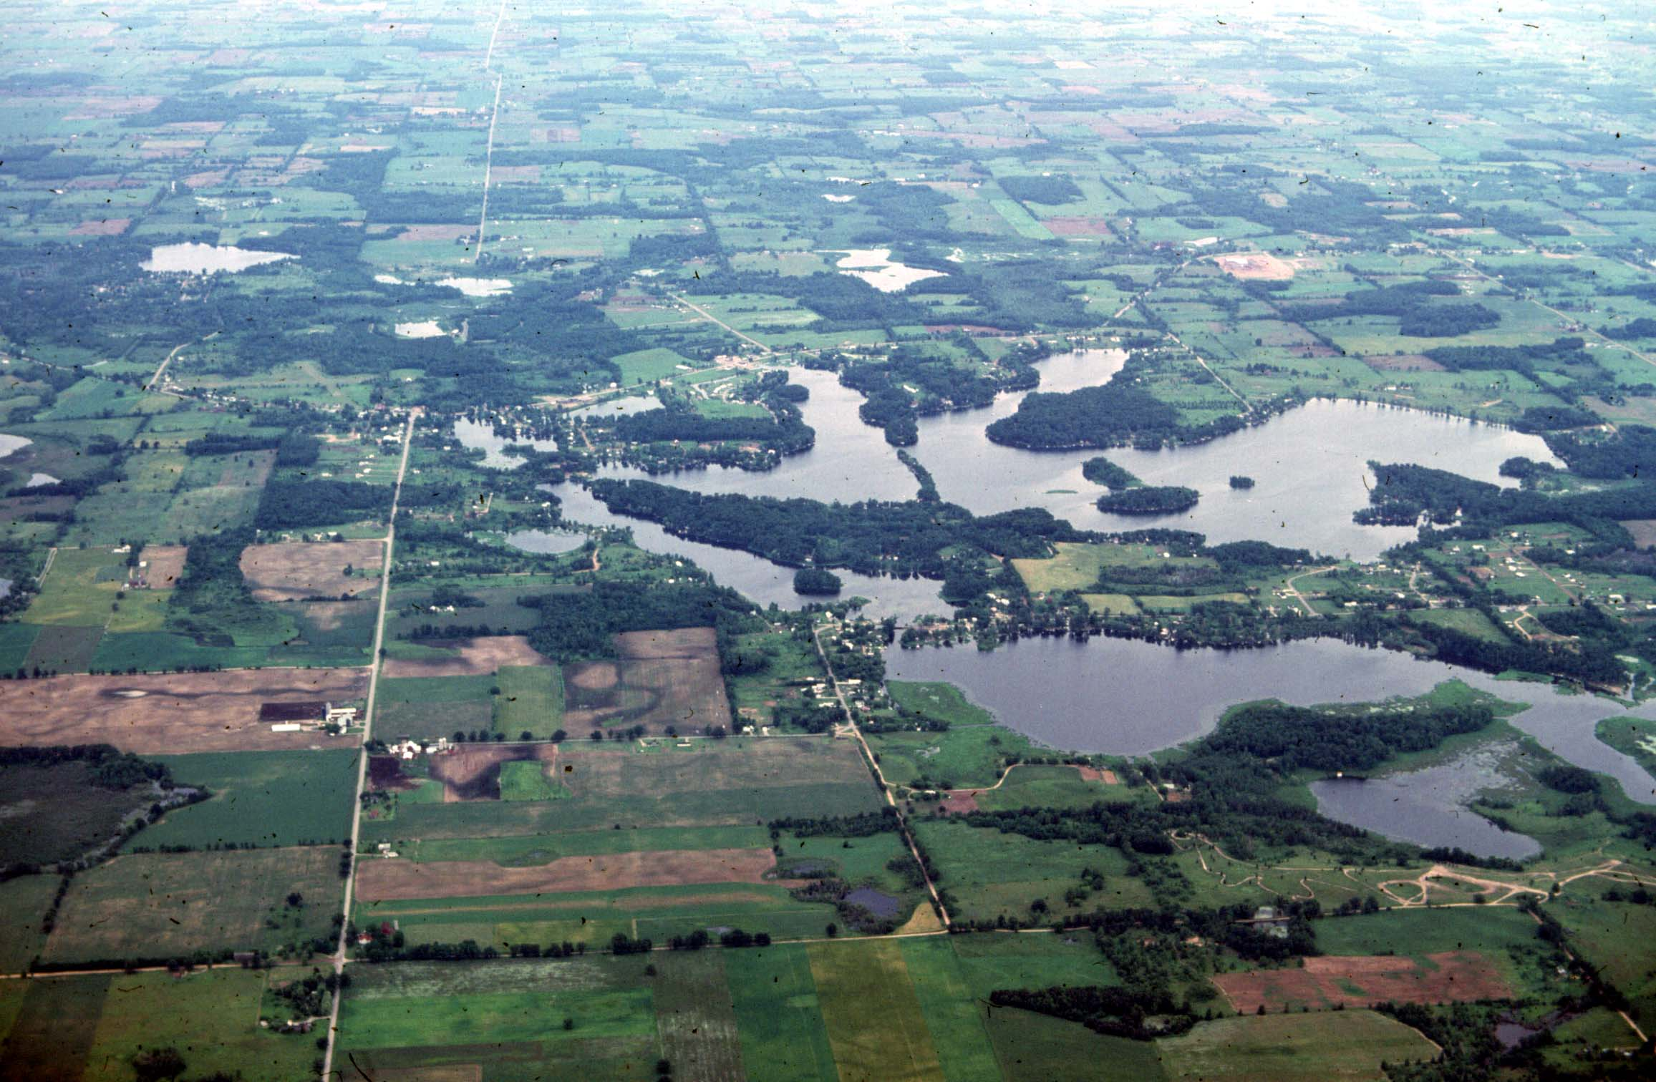
Glacial Deposition
When a glacier melts, it deposits the sediment it was carrying, creating various landforms
Till: any sediment of any size deposited by a glacier
Moraine: a ridge of till formed at the edge of a melting glacier
Kettle: a piece of ice deposited in the till melts and leaves a depression, forming a small lake or pond.

Slide 13
Glacial Moraines of Ohio

