Slide 1
Energy Supply to muscles & Types of Contractions
Subtitle

Slide 2
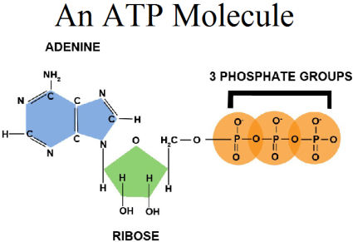
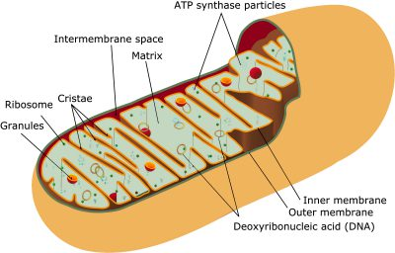
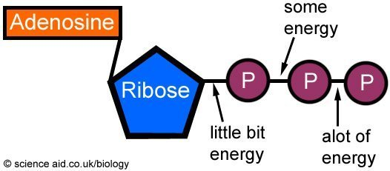
What is ATP?
Energy currency of the cell
Mitochondria and cellular respiration
ATP → ADP and vice versa

Slide 3
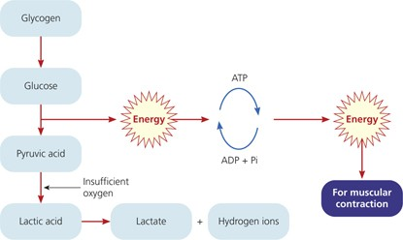
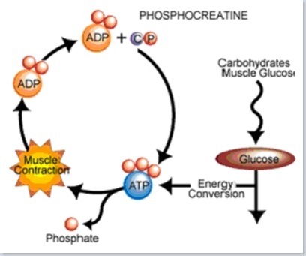
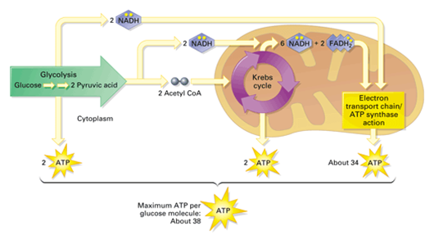
ATP and Muscle Function
Muscles need ATP to contract
Three sources of ATP for muscles:
Direct phosphorylation of ADP by creatine phosphate (CP)
Aerobic cellular respiration
Anaerobic glycolysis and lactic acid formation

Slide 4
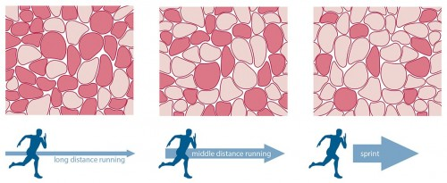
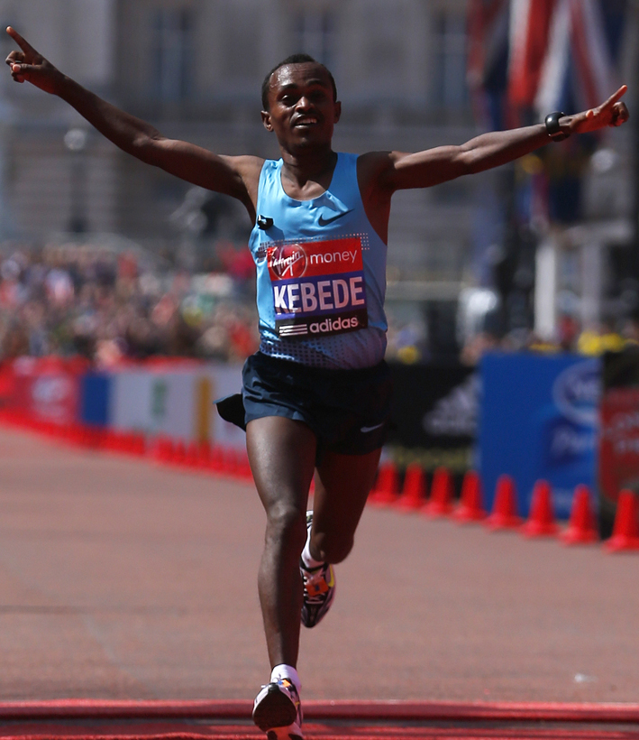
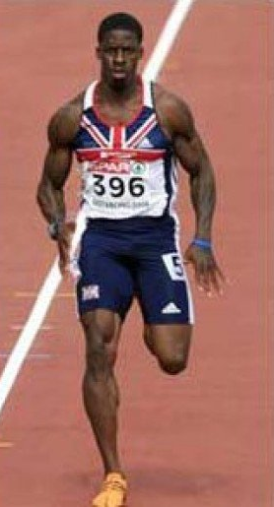
Muscle Fatigue
Muscles and exercise
Oxygen Deficit
Red muscle fibers
White muscle fibers
Which person is the sprinter and the distance runner? How do you know?

Slide 5
Muscle Contractions
What is a muscle contraction?
Isotonic Contractions
Isometric Contractions
Muscle Tone

